Slide 1
Unit 1 Programming in Java

Slide 2
Introduction
Java was created by Sun Microsystems Inc. in 1991, later acquired by Oracle Corporation.
Java was originally developed by James Gosling and Patrick Naughton.
There are estimated more than 3 billion (and counting) devices running Java

Slide 3
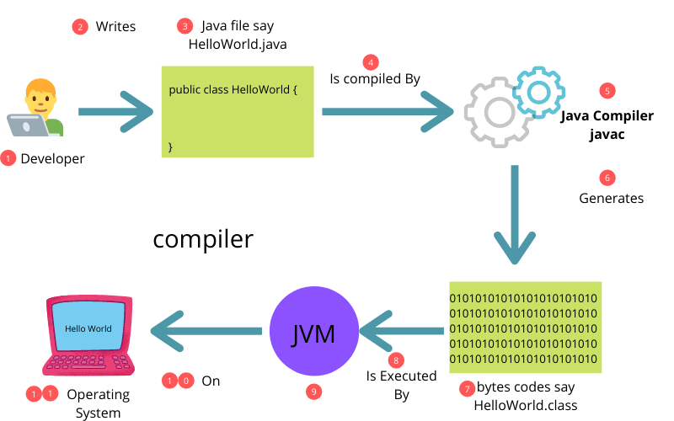
Java Architecture

Slide 4
Java Architecture
Java Source Code
Java Compiler – source code to bytecode (.class file)
Bytecode – executed by JVM(Java Virtual Machine) making Java machine independent
Class Loader – for loading classes(bytecode) into memory when they are needed

Slide 5
How Java Works?
Source code is written
Java compiler converts java code into bytecode
After that, JVM converts byte code into machine code
The machine code is then executed by machine

Slide 6
Components of Java Architecture
JDK (Java Development Kit)
Development tools : AppletViewer, javadoc, jar, jarsigner, extcheck, apt, etc.
JRE (Java Runtime Environment)
JVM + Libraries : code libraries, dll(dynamic link library) files, extension files, security files, etc.
JVM (Java Virtual Machine)
Garbage collector, class loader, JIT compiler, etc.

Slide 7
Path and ClassPath variable
Path variable
Environment variable used by OS to locate executable files
E.g use of java or javac command in terminal without specifying the full path
ClassPath variable
Environment variable that specifies JVM to look for classes and JAR files.
E.g export CLASSPATH=/path/to/directory.jar

Slide 8
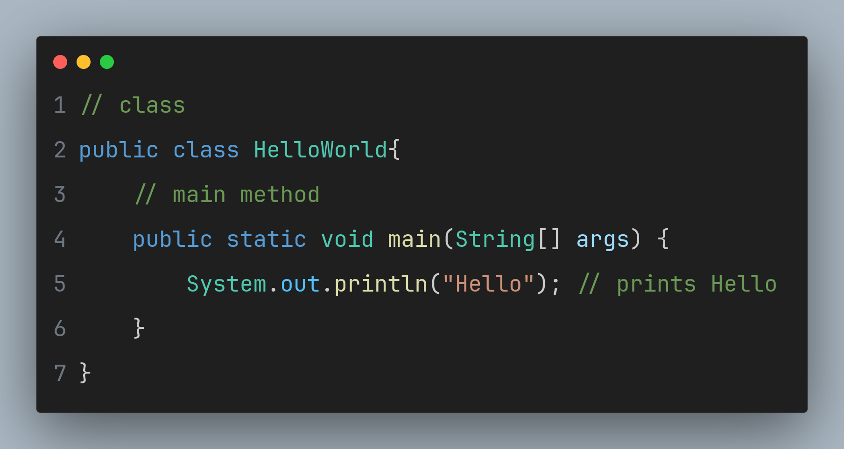

Slide 9
Compile and Run Java Program
Compile the program
javac HelloWorld.java
Run the program
java HelloWorld

Slide 10
Java Class
Class is a blueprint from which we can create multiple objects
It is a template which provides the initial values for state (member variables) and provides an implementation for methods or behavior
Syntax:
class ClassName{
// member variables
// methods or behavior
}

Slide 11
Java Object
Object is an instance of a class (i.e. it is copy of a class)
It has its own methods and data variables
You can create multiple objects of one class
To create an object we specify class name followed by object name and use new keyword.
Syntax :
Student s = new Student();
Here, s is an object.

Slide 12
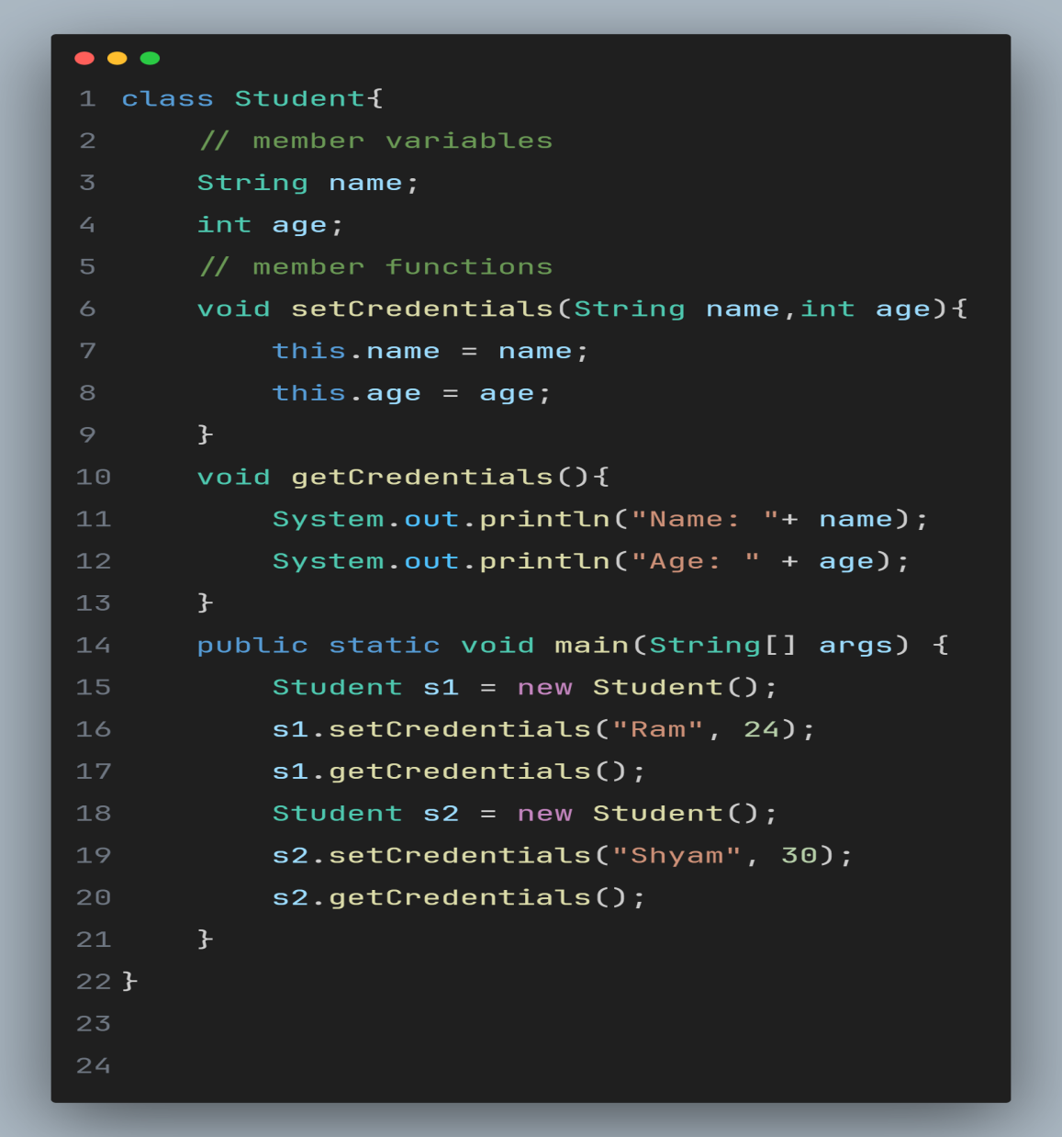

Class and Object Example
Output :
Here,
Student is a class
s1 and s2 are two objects

Slide 13
Constructors
Constructors in java allows auto initialization of objects at the time of its creation
and is called using new keyword
It has same name as class name with no return type and is similar to a method
There are two types of constructors : default and parameterized
Student{
String name;
// parameterized constructor
Student(String name){
this.name = name;
}
}
Student{
// default constructor
Student(){
}
}
// calling default constructor
Student s1 = new Student();
// calling parameterized constructor
Student s2 = new Student(“Ram”);
Parameterized constructor example
Default constructor example

Slide 14
Interface in Java
Interfaces are similar to class in java with some major differences :
We can only declare method signature but can’t provide its implementation and methods declared in an interfaces are implicitly public and abstract
Class can implement multiple interfaces
To implement an interface in a class you use “implements” keyword
Classes that implement interface must provide method implementations
Interface is used to achieve polymorphism
They are commonly used to define contracts that classes must implement
Some interfaces available in Java are “List”, “Set”, “Map” , etc.
They cannot be instantiated and variables defined in interface are by default public, static and final.

Slide 15
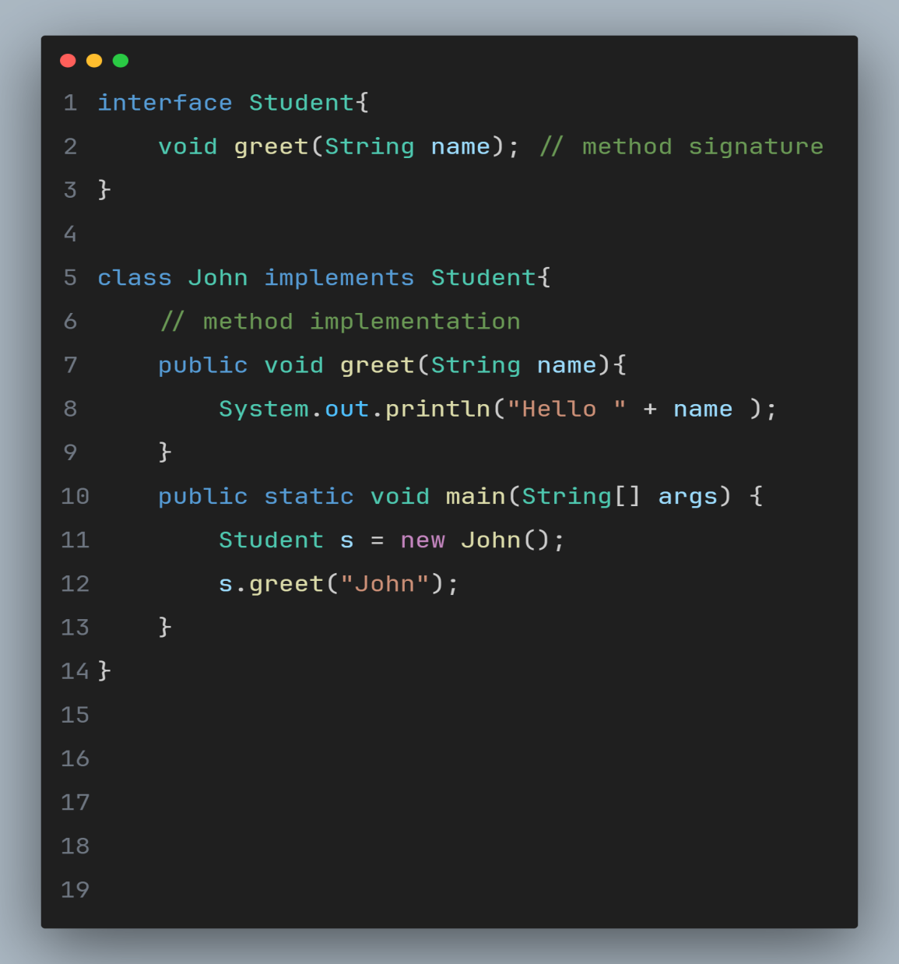
Interface Example
Output :

Slide 16
Access Modifiers
Access modifiers in java are keywords to determine visibility and accessibility of classes, methods and variables
The main access modifiers in java are public, protected, default, private
Access Modifier | Visibility
public | Accessible from anywhere.
protected | Accessible within the same package and by subclasses.
Default | Accessible only within the same package.
private | Accessible only within the class only.

Slide 17
Arrays
Array is a data structure that can store the multiple values of same data type
Declaration and initialization
int[] numbers; // declaring integer array
int[] numbers = {1,2,3,4,5}; // initializing with values
int[] numbers = new int[5]; // initializing with size
Accessing elements
numbers[0]; // accessing the first element = 1
Array length
numbers.length; // length gives 5

Slide 18
Arrays
Iterating over arrays
for(int i = 0; i < numbers.length ; i++) {
System.out.println(numbers[i]);
}
for(int num : numbers) {
System.out.println(num);
}
2D array
int[][] matrix = {{1, 2, 3}, {4, 5, 6}};
int value = matrix[0][1]; // Accessing the element at row 0, column 1 = 2

Slide 19
Packages
Package in Java is a way to organize and group related classes and interfaces
Package Declaration
package myPackage; // declaration
Package Structure
package myPackage.subPackage; // subpackage subPackage inside myPackage
Importing package
import myPackage.Student; // importing Student class from within myPackage
import myPackage.*; // using wildcard to import all classes from myPackage
Java Standard Library Packages
some of the in build packages in java are java.lang, java.util, java.io, etc.

Slide 20
Inheritance
Inheritance in Java allows to create a child or derived or subclass that inherits properties and behaviors from an existing or parent or base or superclass.
To create a subclass that inherits from a superclass, we use “extends” keyword
There are various types of inheritance like single, multiple, multi-level, hierarchical, hybrid
is-a relationship
subclass is a specialized version of the superclass
class Animal{}
class Dog extends Animal{}
Here, we can say Dog is a animal.

Slide 21
Inheritance
has-a relationship
also known as composition or aggregation
relationship with another class as a whole or partially
class WhiteBoard{}
class ClassRoom{
private WhiteBoard obj; // ClassRoom has-a WhiteBoard (composition)
}

Slide 22
“this” keyword
This keyword in Java is reference to the current instance of the class in which it appears
Often used to differentiate between instance variable and method parameters with same name
Also used to invoke one constructor from another within the same class
Example:
public class MyClass {
private int value;
public MyClass(int value) {
this.value = value; // "this" refers to the instance variable
}
}

Slide 23
“super” keyword
Super keyword refer to the immediate parent class
It is used to access the members of the superclass that might be overridden in the current class
Also used to call the parent class constructor using super() call
class Animal {
void makeSound() {
System.out.println("Animal makes a sound");
}
}
class Dog extends Animal {
@Override
void makeSound() {
super.makeSound(); // Calls the makeSound method of the superclass
System.out.println("Dog barks");
}
}

Slide 24
Method overloading
If a class have multiple methods by same name but different parameters, it is known as Method overloading
On the single operation, methods with same name increases the readability of the program (advantage)
Ways to overload method in Java
By changing number of arguments
By changing the data type
Retrun type is not concerned with method overloading

Slide 25
Method overloading(by changing no. of args)
Class Calculation{
void sum(int a, int b){
System.out.println(a+b);
}
void sum(int a,int b,int c){
System.out.println(a+b+c);
public static void main(String args[]){
Calculation obj = new Calculation();
obj.sum(2,3);
obj.sum(1,3,4);
}
}

Slide 26
Method overloading(by changing data type of args)
Class Calculation{
void sum(int a, int b){
System.out.println(a+b);
}
void sum(double a,double b){
System.out.println(a+b+c);
}
public static void main(String args[]){
Calculation obj = new Calculation();
obj.sum(2,3);
obj.sum(1.4,4.4);
}
}

Slide 27
Can we overload main method?
Class Calculation{
public static void main(int a){
sout(a);
}
public static void main(String args[]){
sout(“main method called”);
main(2);
}

Slide 28
Method overriding
If subclass(child class) has the same method as declared in the parent class, it is known as method overriding in Java
It is used to provide specific implementation of a method that is already provided by its super class
It is used for runtime polymorphism
Method has same name and same parameter as parent class

Slide 29
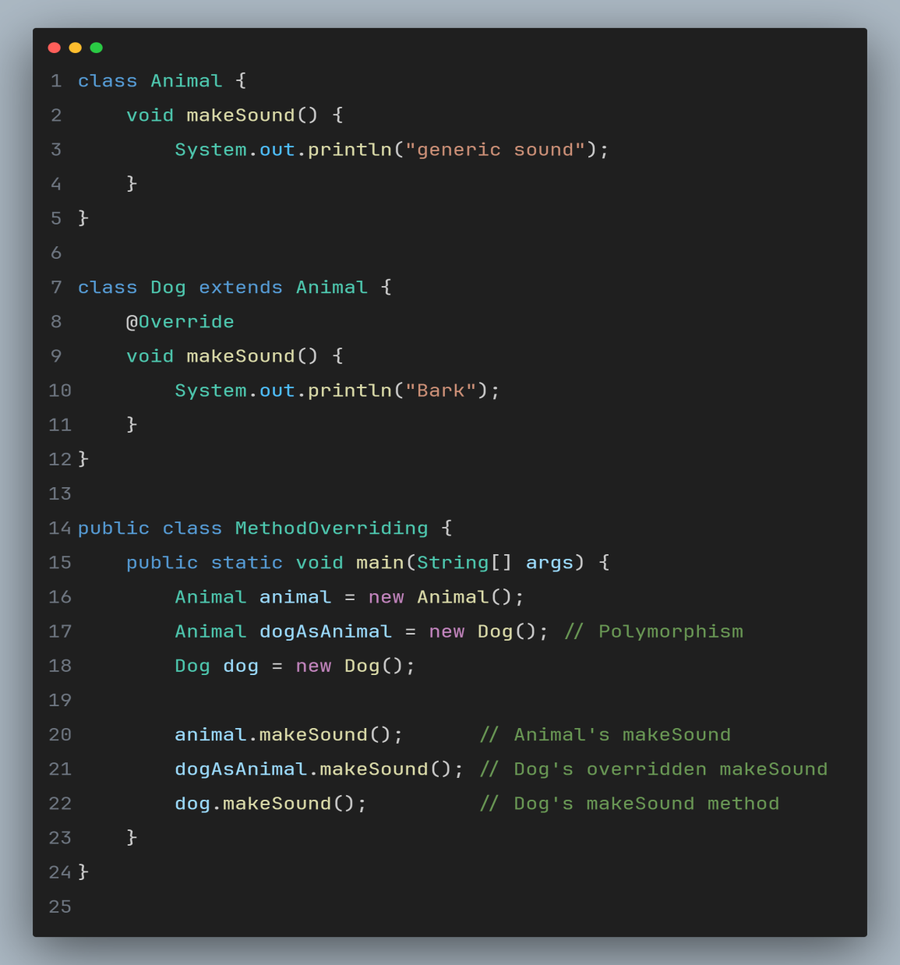
Method overriding (Example)
Output :
Generic sound
Bark
Bark

Slide 30
“final” modifier
In Java, “final” modifier is used to indicate that an element, such as class, method, variable, cannot be further modified once it has been defined or assigned value.
Final Varibales:
final int myConst = 10; // value of myConst can’t be changed
Final Methods:
class Parent{ class Child extends Parent{
final void myMethod(){} void myMethod(){ } // override not allowed
} }
Final Classes:
final class MyClass{ class MyChildClass extends MyClass{ // can’t create subclass
} }

Slide 31
“static” modifier
Static is a keyword that states that all instances of a given class are to share the same variable or method.
Without “static” keyword, it is called “instance variable” and each instance of the class has its own copy of variable
Variable declared with “static” keyword is also known as “class variable”
static int x = 10; // should be initialized while declaring
Static method
static void greet(){
}
Note:
Static method cannot have non-static variables and non-static methods
We can’t use “this” reference inside static method and can’t override static method

Slide 32
Exception Handling in Java

Slide 33
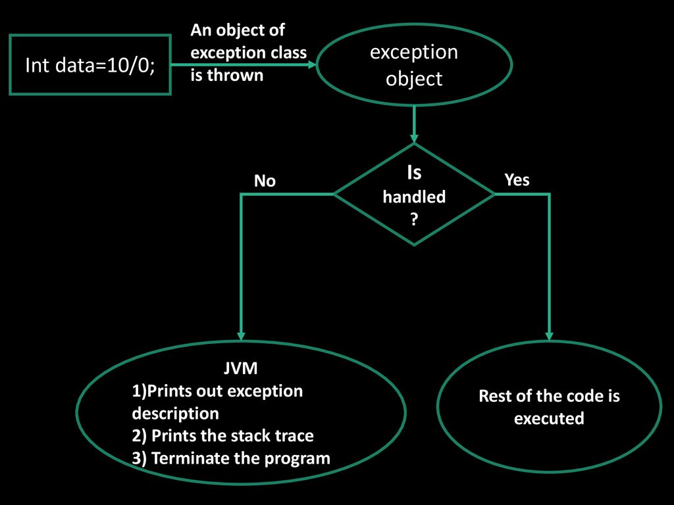

Slide 34
Try-catch block
try{
// statement that cause excpetion (like int a = 10/0;)
}catch(exception(type) e(object)){
// error handling code
}

Slide 35
Multiple catch block
try { //Protected code
} catch(ExceptionType1 e1) {
//Catch block
}
catch(ExceptionType2 e2){
}
……

Slide 36
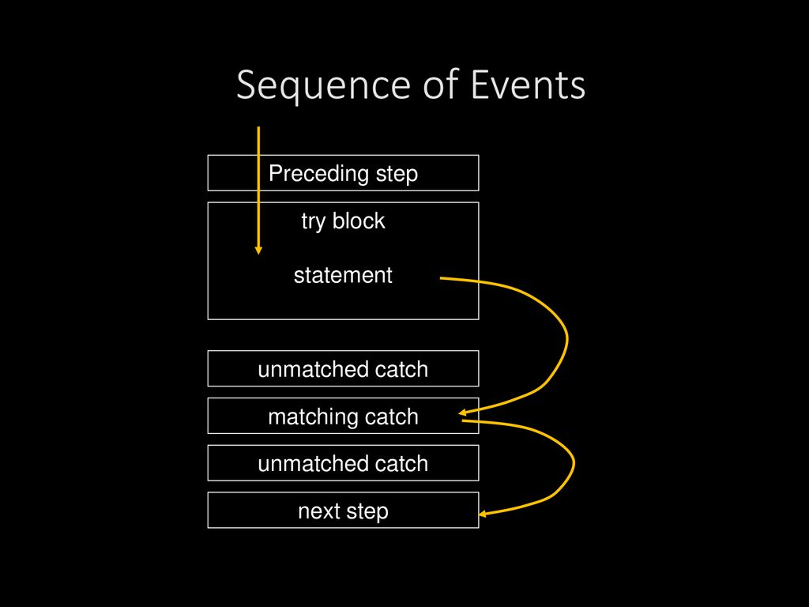
Sequence of events

Slide 37
Sequence of events
try{
int a[]=new int[7];
a[4]=30/0;
}catch(ArithmeticException e){
System.out.println("Warning: ArithmeticException");
}catch(ArrayIndexOutOfBoundsExceptione){
System.out.println("Warning:ArrayIndexOutOfBoundsException");
}catch(Exception e){
System.out.println("Warning: Some Other exception");
}
System.out.println("Out of try-catch block...");

Slide 38
Nested try-catch
One try-catch block can be present in the another try’s body.
This is called Nesting of try catch blocks.
Each time a try block does not have a catch handler for a particular exception, the stack is unwound and the next try block’s catch (i.e., parent try block’s catch) handlers are inspected for a match.
If no catch block matches, then the java run-time system will handle the exception.

Slide 39
Nested try-catch
Example:
try{
try{
}catch(Exception e){
}
}catch(Exception e){
}

Slide 40
Finally Block
A finally statement must be associated with a try statement.
It identifies a block of statements that needs to be executed regardless of whether or not an exception occurs within the try block.
It will run regardless of whether an exception was thrown and handled by the try and catch parts of the block.
try{
}catch(Exception e){
}finally{
}

Slide 41
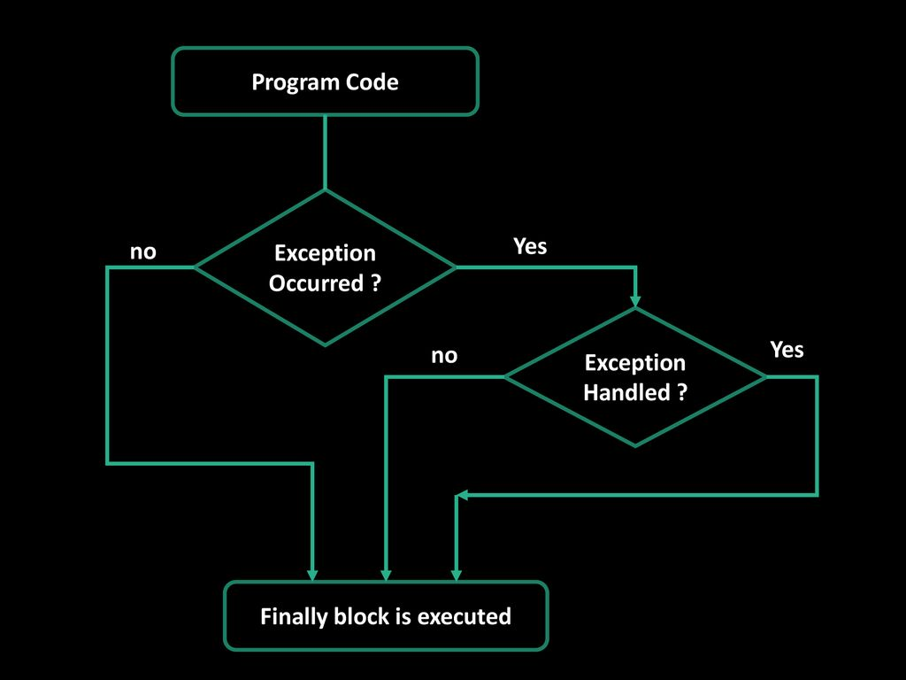

Slide 42
“throw” keyword – our own exceptions
In java we have already defined exception classes such as ArithmeticException, NullPointerException etc.
These exceptions are implicitly thrown by JVM
The throw keyword is used to explicitly throw an exception.
These exceptions are known as user-defined exceptions.
Syntax :
throw new AnyThrowableInstance;
e.g throw new ArithmeticException;

Slide 43
“throw” keyword – example
int age = 17;
try {
if(age < 18){
throw new ArithmeticException("Not eligible to vote");
}
} catch (ArithmeticException e) {
// e.printStackTrace();
System.out.println(e.getMessage());
}

Slide 44
“throws” keyword
The throws keyword is used to declare an exception.
It gives an information to the programmer that there may occur an exception.
So it is better for the programmer to provide the exception handling code so that normal flow can be maintained.
Syntax of throws keyword:
void method_name() throws exception_class1,exception_class2, ….
{
...
}

Slide 45
“throws” example
public class ExHandling {
public static void main(String[] args) throws ArithmeticException,NullPointerException {
}
}

Slide 46
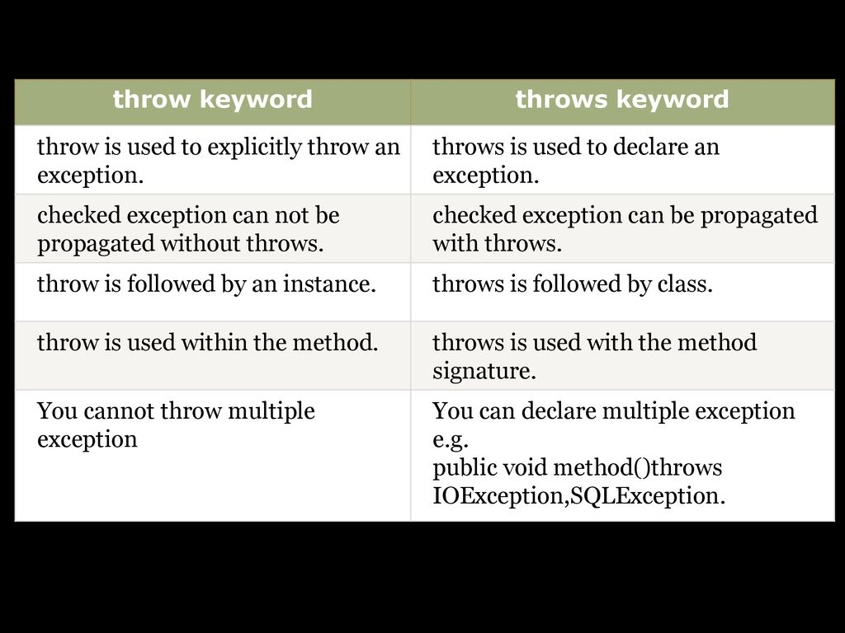
“throw” vs “throws”

Slide 47
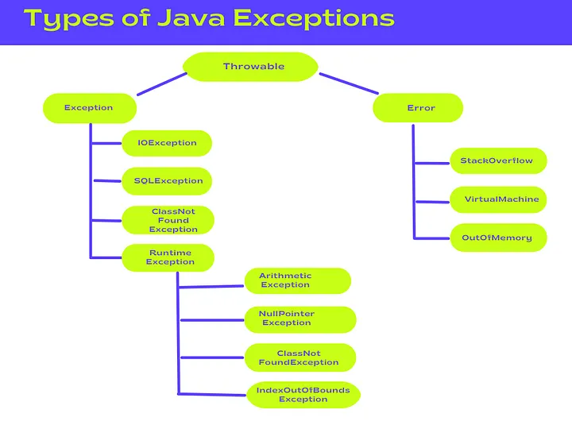

Slide 48
Custom exception class
In Java, you can create your own custom exception classes by extending either the Exception class or one of its subclasses.
Extending Exception (for checked exceptions)
public class CustomCheckedException extends Exception {
public CustomCheckedException(String message) {
super(message);
}
}
Extending RuntimeException (for unchecked exceptions)
public class CustomUncheckedException extends RuntimeException {
public CustomUncheckedException(String message) {
super(message);
}
}

Slide 49
Concurrency - ability of Java to run multiple operations simultaneously

Slide 50
Thread
Thread is a smallest unit of a program’s execution that allows for concurrent execution of tasks within a program
Threads can be used to perform multiple operations simultaneously
Creating threads:
By extending “Thread” class and overriding run() method
Implementing “Runnable” interface and passing an instance to “Thread” constructor
Thread are started using start() method which internally calls run() method

Slide 51
Multi-threading
Process of executing multiple threads simultaneously
Multithreading enables to write efficient programs that make maximum use of the CPU because idle time can be utilized to maximum potential
Creating multithreaded program using Runnable interface
It involves in implementing “run()” method within a separate class and creating and starting threads based on instance of that class
Creating multithreaded program by using Thread class
It involves in extending “Thread” class and overriding “run()” method

Slide 52
Multi-threading
public class MyRunnable implements Runnable {
@Override
public void run() {
for (int i = 1; i <= 5; i++) {
System.out.println(Thread.currentThread().getId() + ": " + i);
}
}
}
public class Main {
public static void main(String[] args) {
// Create instances of MyRunnable
Runnable myRunnable1 = new MyRunnable();
Runnable myRunnable2 = new MyRunnable();
// Create Thread objects and start the threads
Thread thread1 = new Thread(myRunnable1);
Thread thread2 = new Thread(myRunnable2);
thread1.start();
thread2.start();
}
}
Implementing Runnable Interface

Slide 53
Multi-threading
class MyThread extends Thread {
public void run() {
for (int i = 1; i <= 5; i++) {
System.out.println("Thread: " + Thread.currentThread().getId() + " Count: " + i);
try {
Thread.sleep(1000); // Sleep for 1 second
} catch (InterruptedException e) {
System.out.println("Thread interrupted.");
}
}
}
}
public class MultithreadedExample {
public static void main(String[] args) {
MyThread thread1 = new MyThread();
MyThread thread2 = new MyThread();
thread1.start(); // Start the first thread
thread2.start(); // Start the second thread
}
}
Extending Thread Class

Slide 54
Thread methods
Methods | Description
getName() | Get thread’s name
getPriority() | Get thread’s priority
isAlive() | Get if a thread is still running
join() | Wait for thread to terminate
run() | Entry point for thread
sleep() | Pause thread for specific time (ms)
start() | Start a thread by calling run() method

Slide 55
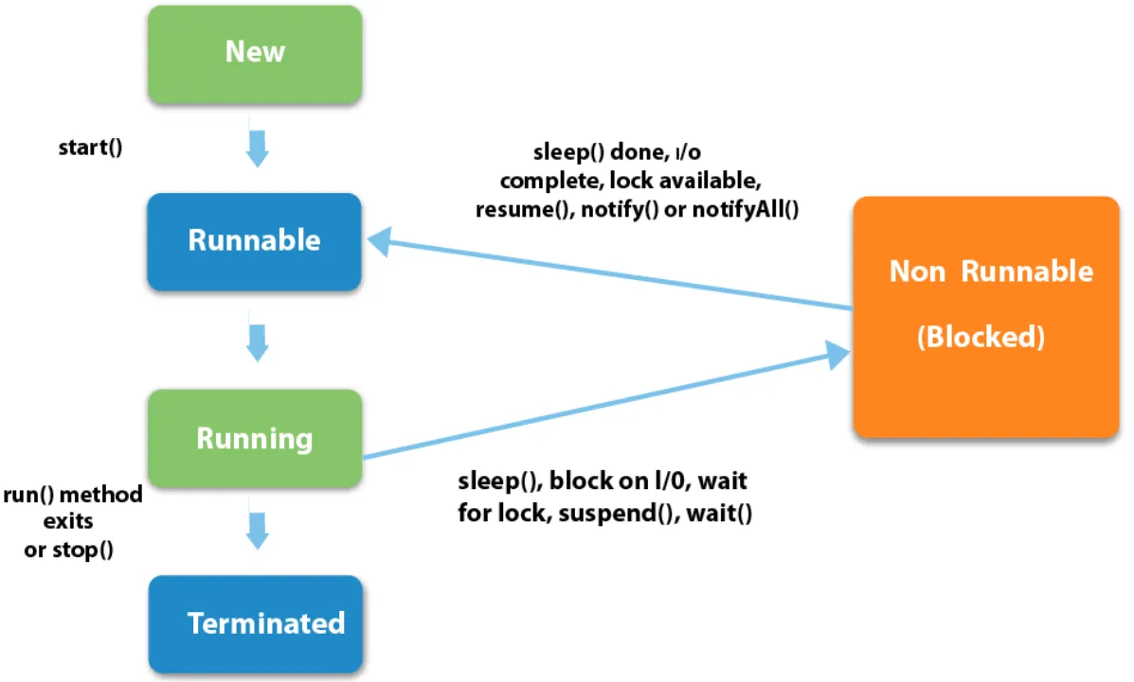
Thread
Life Cycle

Slide 56
Thread Life Cycle
New
The thread is in “new” state when it has been created but not started yet.
This means the Thread object is created but start() method has not been
called.
Active (Runnable and Running)
Runnable state means it is now eligible to run but not executing at the moment when start() method is called and waits for CPU time
Running means start() method is being executed after getting CPU time
Note:
start() method invokes the run() method
OS scheduler determines when to run thread

Slide 57
Thread Life Cycle
Blocked/Waiting
A thread enters blocked state for various reasons. One common reason is when thread is waiting for lock held by another thread.
Second reason is when a thread is explicitly paused using methods like Thread.sleep() or Object.wait()
Timed Waiting
Threads in blocked/waiting state can enter the Timed Waiting when they are paused for specified amount of time by using Thread.sleep(long ms) or Object.wait(timeout)
Terminated
A thread enters terminated state when run() method completes execution
We can check if a thread has terminated using Thread.isAlive() method.

Slide 58
Working with Files

Slide 59
Java I/O Streams
In Java, I/O (Input/Output) streams are used to read data from or write data to various sources, such as files, network connections, or in-memory data structures.
Java provides a comprehensive set of classes and interfaces for working with I/O streams, which are part of the java.io and java.nio packages
Java I/O streams are organized into two major categories:
Byte Streams
Character Streams

Slide 60
Character Streams vs Byte Streams
Character streams and byte streams are two distinct categories of I/O streams in Java, each designed for handling different types of data. The primary difference between them is in how they process and represent data.
Byte Streams: These handle I/O of raw binary data. They are suitable for handling all kinds of data, including text, images, audio, and more. The primary classes for byte streams are InputStream and OutputStream
Character Streams: These are used specifically for character data, such as reading and writing text files. The primary classes for character streams are Reader and Writer.

Slide 61
Character Streams
Character streams are used for reading and writing text data, which consists of characters (e.g., letters, digits, symbols) encoded in character encodings like UTF-8, UTF-16, or ASCII.
reading and writing text files, parsing configuration files, and handling character-based data formats like XML, HTML, and JSON.
convert characters into bytes when writing to a file and convert bytes into characters when reading from a file.
Key Character Stream Classes:
Reader: The abstract base class for reading character data.
Writer: The abstract base class for writing character data.
subclasses include FileReader, FileWriter, BufferedReader, and BufferedWriter.
Example:
FileReader reader = new FileReader("text.txt");
BufferedReader bufferedReader = new BufferedReader(reader);
String line = bufferedReader.readLine();

Slide 62
Byte Streams
Byte streams are used for reading and writing binary data, which can represent any type of data, including text, images, audio, video, or any arbitrary binary format.
They are suitable for handling raw binary data where character encoding is not a concern, such as working with image files, audio files, or network protocols.
Byte streams directly read and write bytes without any character encoding conversion.
Key Byte Stream Classes:
InputStream: The abstract base class for reading byte data.
OutputStream: The abstract base class for writing byte data.
subclasses include FileInputStream, FileOutputStream, DataInputStream, and DataOutputStream.
Example:
FileInputStream inputStream = new FileInputStream("binary.dat");
byte[] buffer = new byte[1024];
int bytesRead = inputStream.read(buffer);

Slide 63
Stream Classes | Summary
FileInputStream | Reads bytes from file
ByteArrayInputStream | Read bytes from in-memory byte array
BufferedInputStream | Provides buffering for improved performance
DataInputStream | Reads primitive data types (int,double,etc.)
ObjectInputStream | Reads objects that have been serialized
FileOutputStream | Writes bytes to a file
ByteArrayOutuputStream | Writes bytes to an in-memory byte array
BufferedOutputStream | Provides buffering for improved performance
DataOutputStream | Writes primitive data types (int, double, etc.)
ObjectOutputStream | Writes objects that can be serialized
Byte Stream Classes
PipedInputStream | Used for communication between two threads
PipedOutputStream
SequenceInputStream | To cocatenate multiple input streams and present as single stream
RandomAccessFile | Allow both reading and writing to binary data to a file. It provides methods for direct access to specific file positions

Slide 64
Stream Classes | Summary
FileReader | Reads character from a file
InputStreamReader | Input stream that translates bytes to characters
StringReader | Reads characters from string
BufferedReader | Provides buffering for improved performance
CharArrayReader | Reads character from in-memory character array
FileWriter | Writes characters to a file
OutputStreamWriter | Output stream that translates bytes to characters
StringWriter | Writes character to string
BufferedWriter | Provides buffering for improved performance
CharArrayWriter | Writes characters to an in-memory character array
Character Stream Classes
PrintWriter | writing formatted text to various output destinations, including files and console
Console | for reading and writing characters to the console
PipedReader | Used for communication between two threads
PipedWriter

Slide 65
Byte Streams Read and Write Example

Slide 66
Character Streams Read and Write Example

Slide 67
InputStream methods
method | description
int read() | Reads the next byte of data from the input stream and returns it as an integer. Returns -1 if the end of the stream has been reached. int data = inputStream.read();
int read(byte[] b) | Reads up to b.length bytes of data from the input stream into an array of bytes b.Returns -1 if end of stream reached. byte[] buffer = new byte[1024]; int bytesRead = inputStream.read(buffer);
int read(byte[] b, int off, int len) | Reads up to len bytes of data from the input stream into an array of bytes b, starting at the specified offset ‘off’ byte[] buffer = new byte[1024]; int bytesRead = inputStream.read(buffer, 0, 512);
long skip(long n) | skips over and discards n bytes of data from the input stream
int available() | Returns an estimate of the number of bytes that can be read from the input stream without blocking
void close() | Closes the input stream and releases any associated system resources
void mark(int readlimit) | Marks the current position in the input stream
void reset() | Resets the input stream to the last marked position

Slide 68
OutputStream methods
method | description
void write(int b) | Writes a single byte to the output stream outputStream.write(65); // Writes the ASCII code for 'A'
void write(byte[] b) | Writes an entire byte array to the output stream byte[] data = "Hello, World!".getBytes(); outputStream.write(data);
void write(byte[] b, int off, int len) | Writes a portion of a byte array to the output stream, starting at the specified offset (off) and writing len bytes byte[] data = "Hello, World!".getBytes(); outputStream.write(data, 0, 5); // Writes the first 5 bytes
void flush() | Forces any buffered output bytes to be written to the underlying output stream or destination
void close() | Closes the output stream and releases any associated system resources outputStream.close();

Slide 69
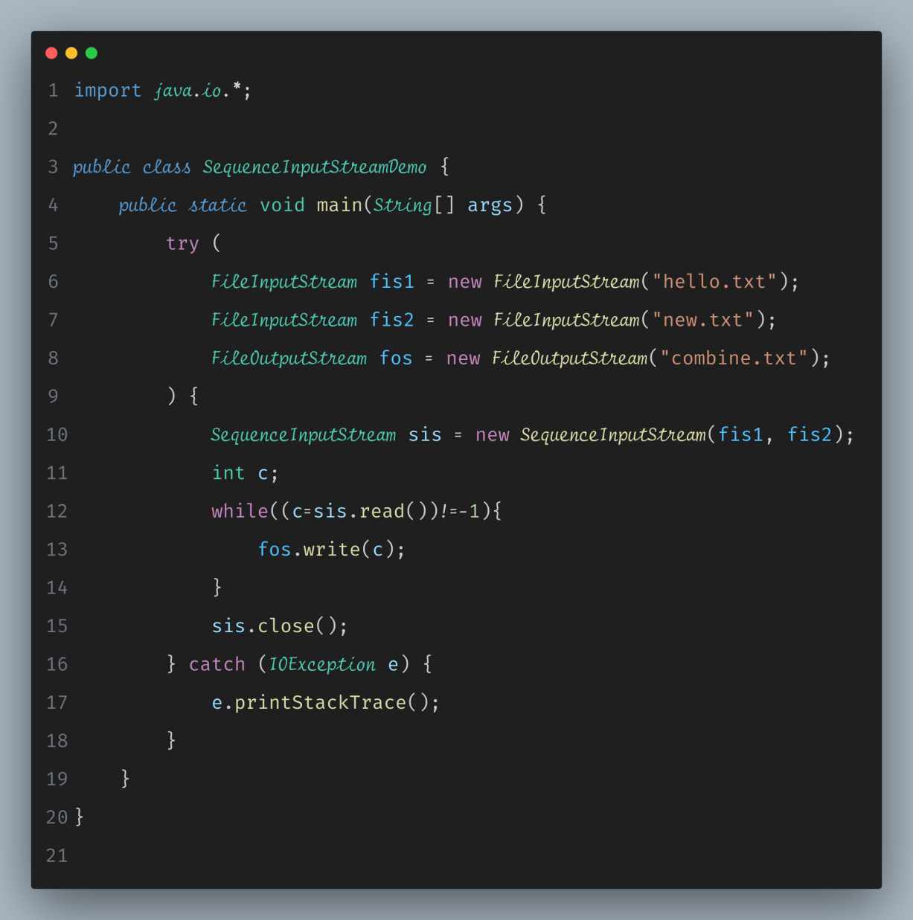
SequenceInputStream Example

Slide 70
Random Access File
In Java, the RandomAccessFile class provides a way to read from and write to a file in a random, non-sequential manner.
This means you can read from or write to any position within the file, not just sequentially from the beginning to the end.
RandomAccessFile is often used when you need to perform tasks like updating specific portions of a file or reading/writing data at specific positions within a file
Creating a RandomAccessFile Instance
RandomAccessFile raf = new RandomAccessFile("example.txt", "rw");
Reading from a RandomAccessFile
int byteRead = raf.read(); // Reads a single byte
byte[] buffer = new byte[1024];
int bytesRead = raf.read(buffer); // Reads multiple bytes into a buffer
Writing to a RandomAccessFile
raf.write(65); // Writes the ASCII code for 'A'
byte[] data = "Hello, World!".getBytes();
raf.write(data); // Writes a byte array to the file
Seeking to a Specific File Position
raf.seek(100); // Move the file pointer to position 100
Getting the Current File Pointer Position
long currentPosition = raf.getFilePointer();

Slide 71
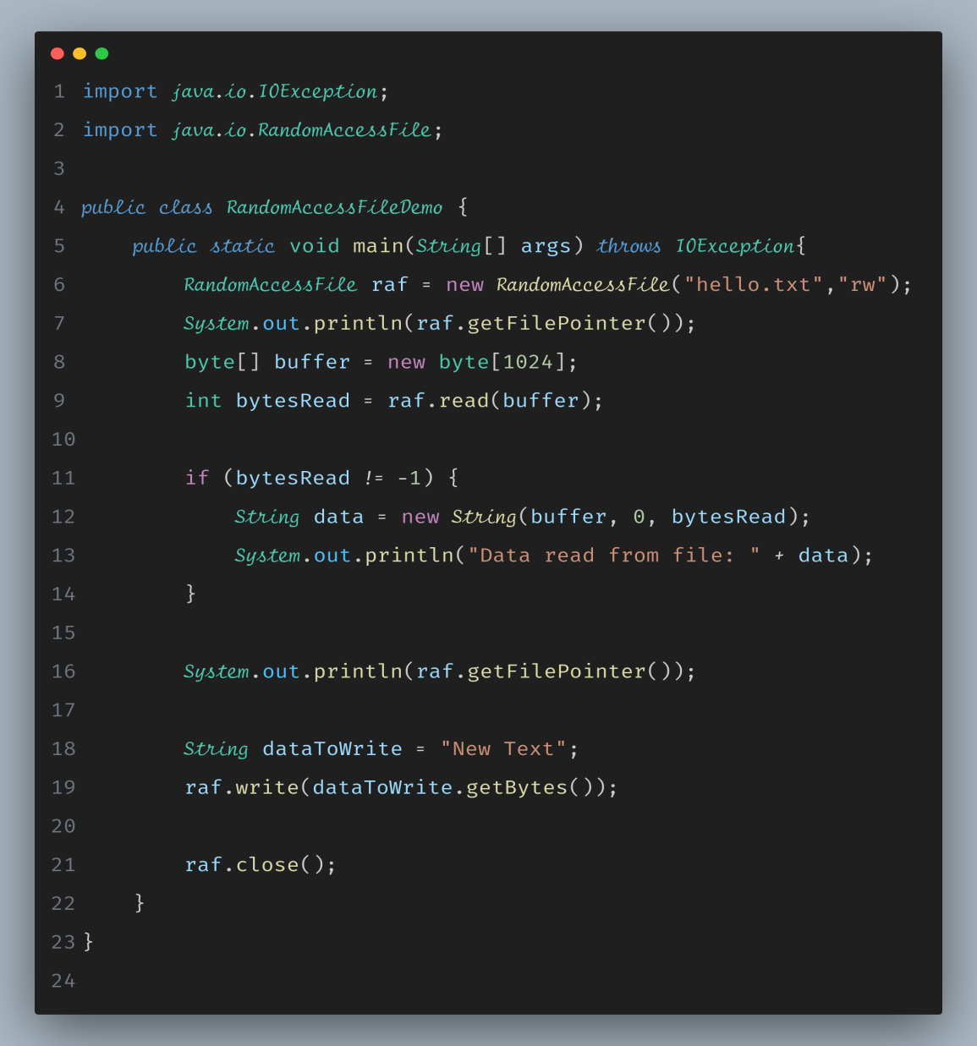
Random Access File Example

Slide 72
Reading and Writing Objects
In Java, we can read and write objects to and from files using Object Serialization.
Object Serialization allows you to convert objects into a stream of bytes, which can be saved to a file, transmitted over a network, or stored in a database
Serializtion
convert objects into a stream of bytes
1. Implement Serializable
2. Create an Object Output Stream
3. Write the Object
Deserialization
recreate the original object from that stream of bytes
1. Create an Input Stream
2. Read the Object

Slide 73
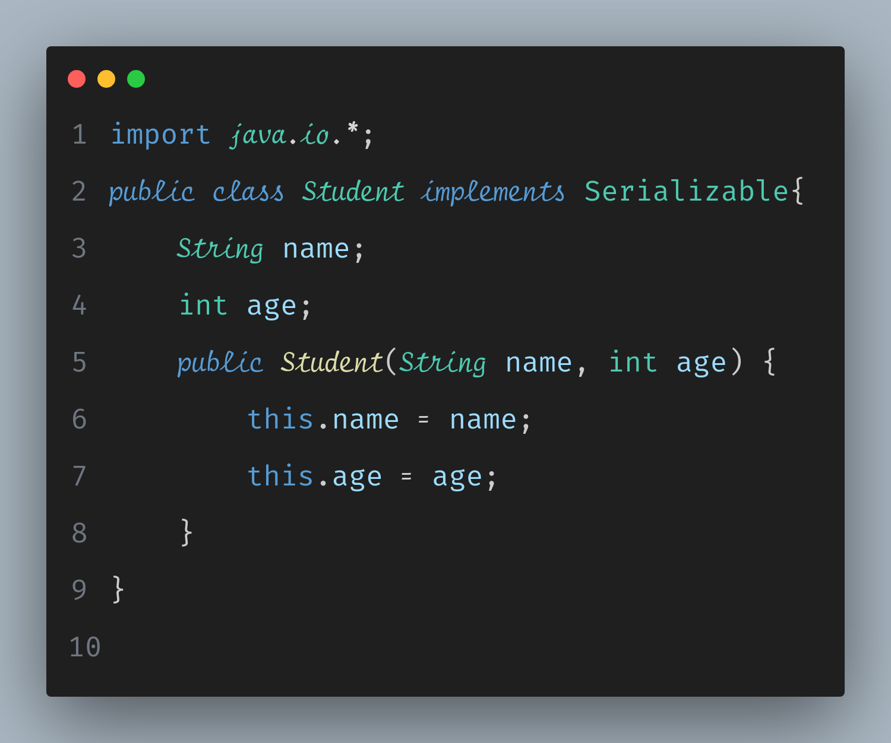
Creating a class to serialize and deserialize

Slide 74
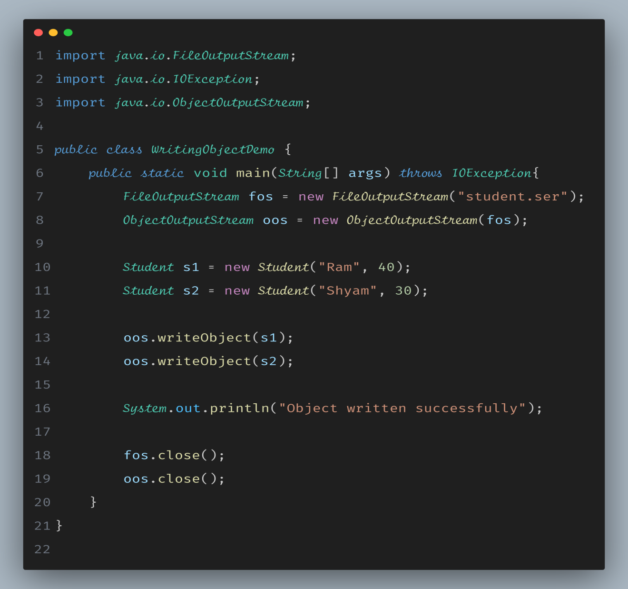
Writing Objects to a File

Slide 75
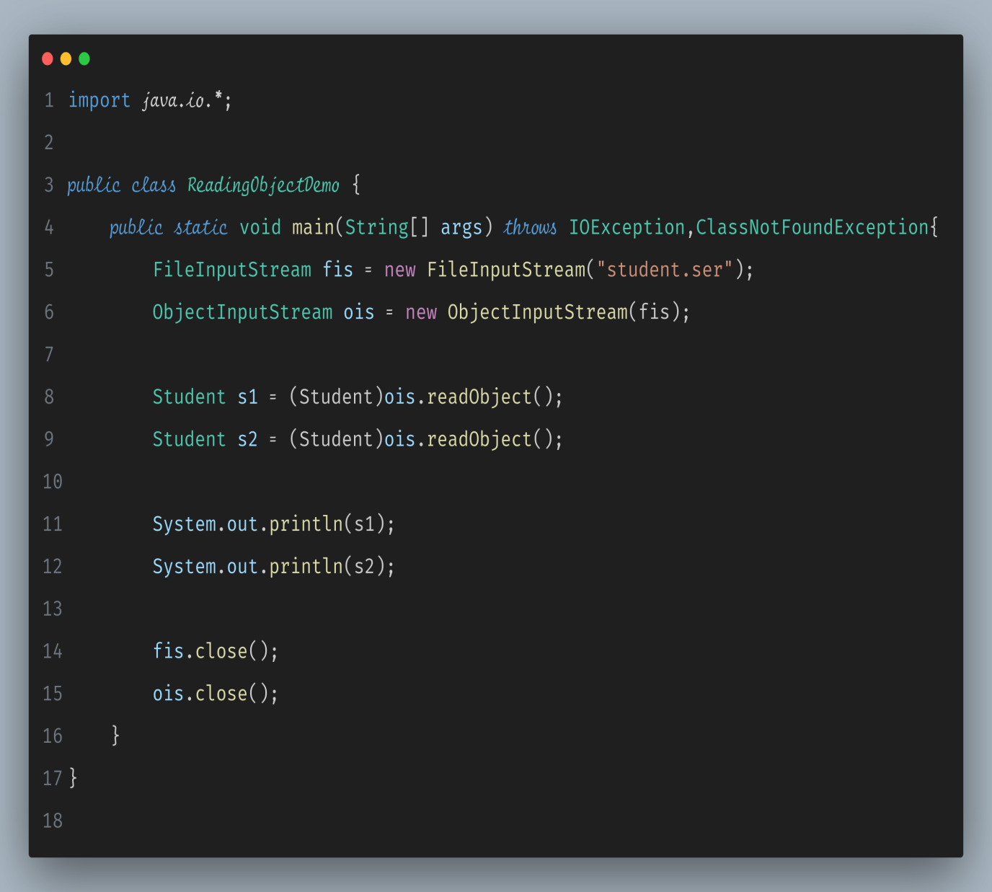
Reading Objects from a File

Slide 76
Java NIO
Known as New I/O or Non-blocking I/O introduced in Java 1.4 provides additional features for Java I/O
NIO is built around the concept of non-blocking, buffer-oriented I/O operations and provides a more efficient mechanism for handling I/O operations, particularly for network programming and large-scale file operations
java.nio package contains api for Java NIO and it does not replace stream based I/O
Channels and Buffers
In Java NIO, data is transferred between a source and a destination using channels and buffers
Different types of channels are available, such as FileChannel, SocketChannel, and ServerSocketChannel
Selectors
A selector allows you to perform non-blocking, multiplexed I/O operations on multiple channels
Buffer Types
Java NIO provides several buffer types, including ByteBuffer, CharBuffer, ShortBuffer, IntBuffer, LongBuffer, FloatBuffer, and DoubleBuffer
File I/O
The FileChannel class provides methods for efficient file I/O operations, including reading and writing data to and from files
Socket I/O
NIO provides SocketChannel and ServerSocketChannel classes for non-blocking network socket communication
Buffer Flipping
Buffers have a flip() method that switches a buffer from write mode to read mode and vice versa

Slide 77
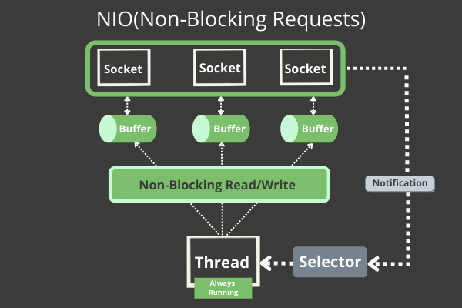
Java NIO

